Slide 1
How to build an Industry Cost Profile (ICP) for a product in Japan
Identify Data Sources for Financial and Manufacturing Information Related to Industry
Step 2
Obtain the Data for Manufacturing and Financial Information Related to Industry
Step 3
Step 1
Use Financial and Manufacturing Information to Calculate Ratios for DM, DL, MOH, COGS, PBT, GSA & Other Expenses

Slide 2
Step 1
Identify Data Sources for Financial and Manufacturing Information Related to Industry
Singapore Government manufacturing & financial statistics are found at:
 | Direct Material (DM)
 | Direct Labor (DL)
 | Manufacturing Overhead (MOH)
 | Cost of Goods Sold (COGS)
 | GSA & Other Expenses
 | Profit Before Tax (PBT)
 | Total Sales
Manufacturing data
Source: Ministry of Economy, Trade and Industry
meti.go.jp
Financial data
Source: Japan Statistics Bureau
*You will use the data sources to express DM, DL, MOH, COGS, GSA & Other Expenses and PBT as ratios, in the form of percentages of Total Sales.
Note: Use financial reports of companies (Income Statement or Profit/Loss Account) as an additional source of Financial data

Slide 3
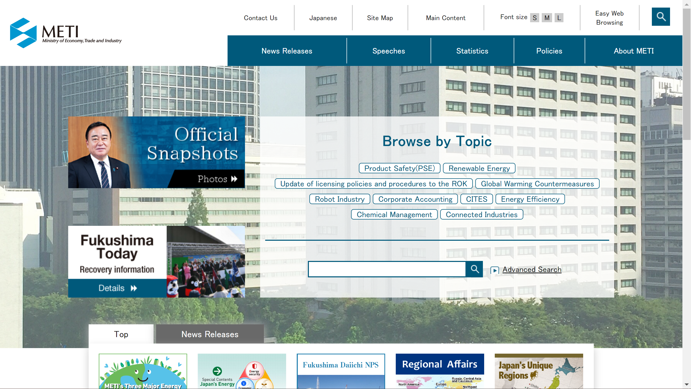
Step 2
Obtain the Data for Manufacturing Information Related to Industry
1. Go to:
2. Click on “Statistics”
2
meti.go.jp

Slide 4
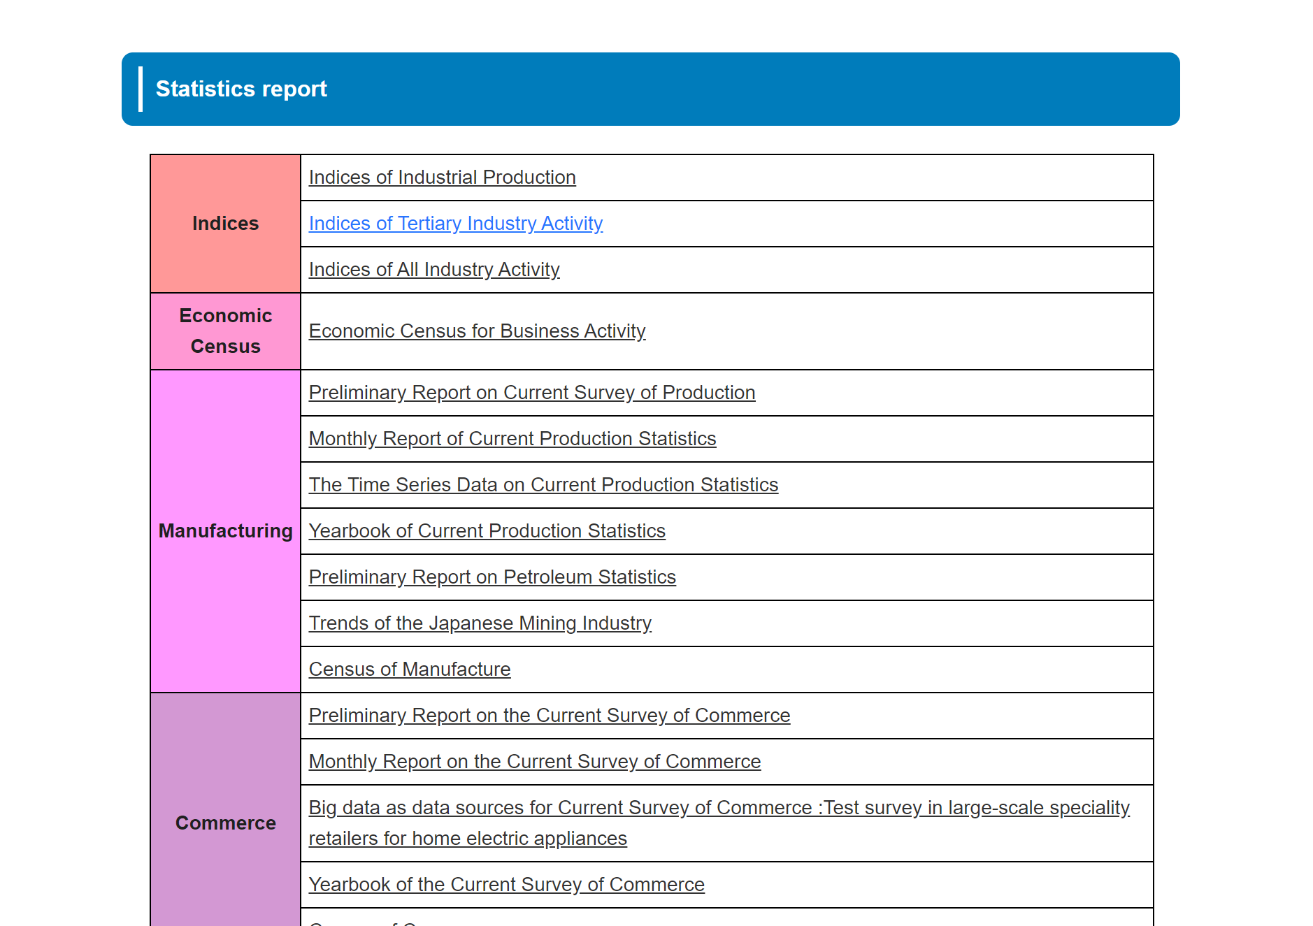
Step 2
Obtain the Data for Manufacturing Information Related to Industry
3. Scroll down to the Statistics Reports Section and click on "Census of Manufacturers"
3

Slide 5
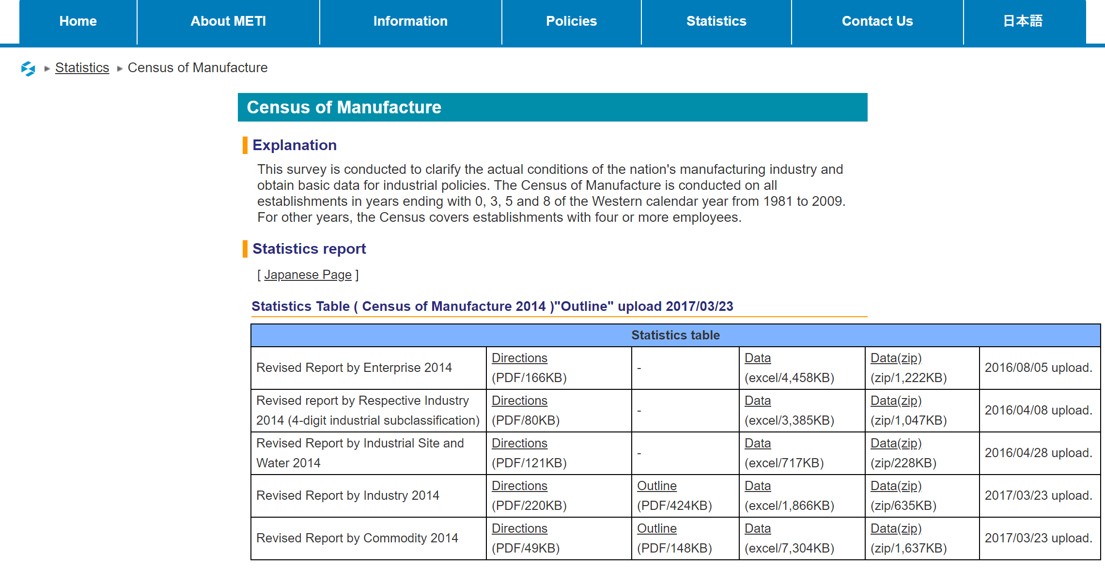
Step 2
Obtain the Data for Manufacturing Information Related to Industry
4. Click on “Data” for Revised report by industry 2014
4

Slide 6
Step 2
Obtain the Data for Manufacturing Information Related to Industry
5. Download the dataset, and locate Industry of interest in “Worksheet 2100” of the excel file
For our Example it is “Manufacturing”
In Table 2 Record the following values:
- Value of total cash wages and salaries
- Value of raw materials, fuels and electricity consumed and subcontracting expenses for consigned production
5

Slide 7
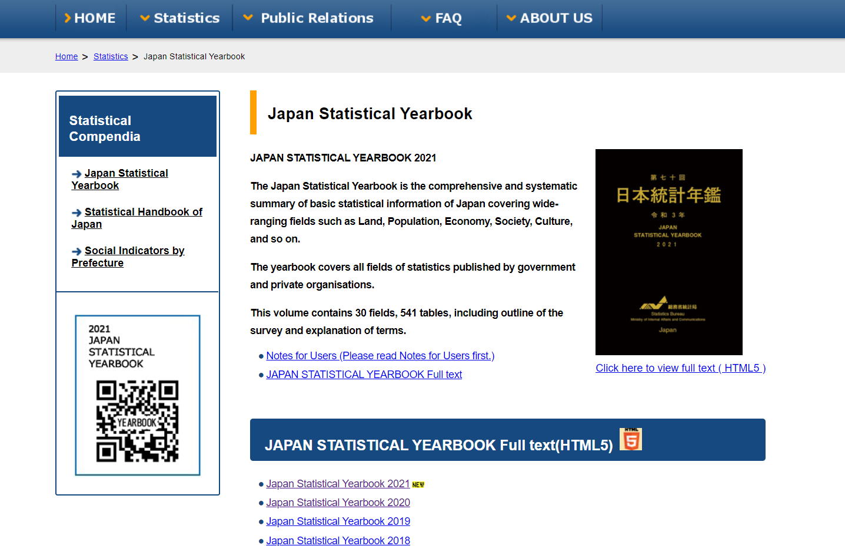
Step 2
Obtain the Data for Financial Information Related to Industry
6. Go to
7. Click on the latest Statistical Yearbook, in this case – “Japan Statistical Yearbook 2021”
6
www.stat.go.jp/english/data/nenkan/
7

Slide 8
Step 2
Obtain the Data for Financial Information Related to Industry
8. Scroll down and click on “Chapter 7 Business Activities” under III Enterprises and Establishments
9. Click on “7-6 B Profit and Loss and Dividend of Surplus” and download the excel file
8
9

Slide 9
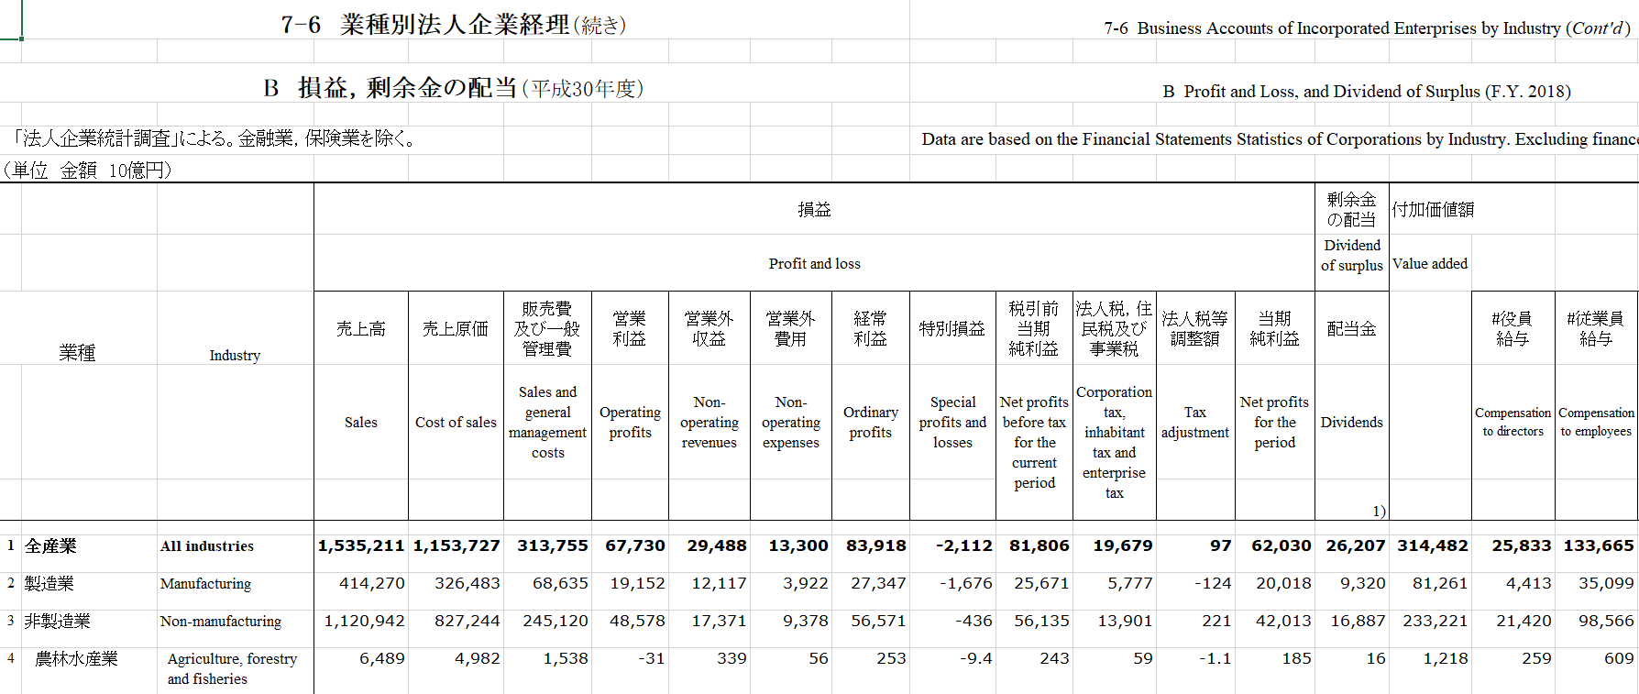
Step 2
Obtain the Data for Financial Information Related to Industry
10. Record the following values for Manufacturing:
- Sales
- Cost of Sales
- Sales and general management costs
- Operating Profits
10

Slide 10
Step 2
Obtain the Data for Manufacturing and Financial Information Related to Industry
Use the USA “Annual Survey of Manufacturers” data to obtain Production Worker Annual Wages as a percentage of Annual Payroll, and the percentage of expenditure for electricity and fuels consumed of materials
Find the Industry of interest by NAICS code
Step 2
Obtain the Annual Payroll, Production Worker Annual Wages & Electricity and Fuels Consumed
Step 3
Step 1
Express Production Worker Annual Wages as a percentage of Annual Payroll, and Electricity and Fuels consumed as of Materials
ICP USA

Slide 11
Step 2
Obtain the Data for Manufacturing and Financial Information Related to Industry
For the “Manufacturing -NAICS 31-33” :
-Annual Payroll 695,617,942
-Production workers annual wages 405,677,912
- Production Worker Annual Wages/ Annual Payroll is 58.32%
- Cost of purchased fuels consumed 34,004,335
- Cost of Electricity 51,664,963
- Total cost of materials 3,339,857,589
- Fuels 1.02% of cost of materials
- Electricity 1.55% of materials

Slide 12
Step 3
Use Financial and Manufacturing Information to Calculate Ratios
In Japan, follow 6 steps to find DM, DL,MOH,COGS, GSA & PBT. Step: 1-2:
1.Calculate Direct Labor using the Production worker annual wages to Annual Payroll ratio from USA data.
2. Calculate Direct Material as a percentage of Sales
 | Sales | 414,270
 | Production Worker Annual Wages/ Annual Payroll | 58.32%
 | Direct Labor
 |  | 4.6%
 | Materials | 197,204
 | - Fuels and Electricity | 197,204*2.57%=5324
 | Direct Material | 192,136
 | Sales | 414,270
 | Direct Material | 46.38%
1.
=0.5832*(32,686/414,270)
2.

Slide 13
Step 3
Use Financial and Manufacturing Information to Calculate Ratios
3. Calculate Cost Of Goods Sold (COGS) as percentage of Sales
4. Calculate MOH % as follows:
 | Cost of Goods Sold | 326,483
 | Sales | 414,270
 | COGS | 78.81%
 | COGS | 78.81%
 | DL | 4.60%
 | DM | 46.38%
 | MOH | 27.83%
3.
MOH = COGS - DL - DM
4.

Slide 14
Step 3
Use Financial and Manufacturing Information to Calculate Ratios
5. Calculate Profit Before Tax (PBT) and SG&A:
 | Operating Profit | 19,152
 | Sales | 414,270
 | PBT | 4.62%
 | Sales and general management costs | 68,635
 | Sales | 414,270
 | SG&A | 16.57%
5.

Slide 15
Present all your calculated ratios in the cost breakdown format
Industry cost profile for “Manufacturing”
 | Direct Material (DM) | 46.38%
 | Direct Labor (DL) | 4.60%
 | Manufacturing Overhead (MOH) | 27.83%
 | Cost of Goods Sold (COGS) | 78.81%
 | GSA & Other Expenses | 16.57%
 | Profit Before Tax (PBT) | 4.62%
 | Total Sales | 100.00%
Manufacturing data
Source: Ministry of Economy, Trade and Industry
Financial data
Source: Japan Statistics Bureau

